Slide 1

IMPROVING THE DIAGNOSIS OF THYROID CANCER BY MACHINE LEARNING AND CLINICAL DATA
Under the Guidance of
Dr. Saroj Kumar Biswas
DEPARTMENT OF COMPUTER SCIENCE AND ENGINEERING
NATIONAL INSTITUTE OF TECHNOLOGY SILCHAR
Aditya KUMAR, SANJEEB KUMAR RAI, RAHUL RAVEL

Slide 2
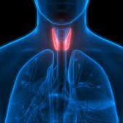
Agenda
Introduction
Motivation
Problem Statement
Work Flow
Summary

Slide 3

Introduction
Thyroid cancer, a frequently encountered form of endocrine carcinoma that affects the thyroid gland, poses a significant diagnostic challenge. The existing methods for detecting thyroid cancer often fall short in providing precise and reliable results. In response to this critical issue, our study endeavors to revolutionize the diagnosis of thyroid cancer by leveraging the capabilities of machine learning in conjunction with valuable clinical data. Through this innovative approach, we aim to not only enhance the accuracy of thyroid cancer diagnosis but also pave the way for more effective and informed medical decisions.

Slide 4

LIMITATIONS IN CURRENT Diagnosis
PRESENTATION TITLE
Subjectivity and variability
Human assessment of thyroid nodule malignancy can be subjective and prone to
Variability.
2. Time and resource constraints
Manual assessment of thyroid nodules can be time-consuming and resource-
intensive
3. Limited diagnostic accuracy
Human assessment alone not provide sufficient accuracy in determining nodule
malignancy
4

Slide 5
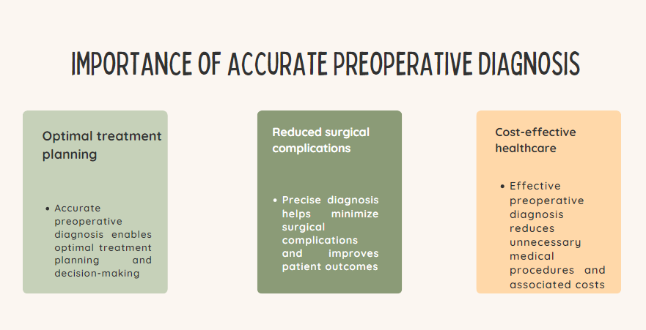
MOTIVATION FOR THE PROJECT

Slide 6
DEFINED PROBLEM STATEMENT:
TO IDENTIFY IF A PERSON HAS THYROID CANCER (BINARY CLASSIFICATION)
TO PREDICT THE TYPE OF THYROID CANCER (MULTICLASS CLASSIFICATION)

Slide 7
EXPECTED OUTCOMES
Accurate binary classification model for thyroid cancer detection.
Precise multi-class classification model for thyroid cancer type prediction.
Risk assessment
Enhanced early diagnosis and tailored treatment recommendations.
Improved patient care and outcomes in thyroid cancer cases.

Slide 8
LITERATURE SURVEY Based on Thyroid Cancer
S. No. | Authors & Publishers | Title | Purposed Method | Dataset | Intuition
1. | Nguyen, Q. T. et al | Diagnosis and treatment of patients with thyroid cancer | The prognosis and treatment of thyroid cancer depend on the type of cancer and the tumor stage at the time of diagnosis. Many thyroid cancers remain stable, microscopic, and indolent. Total thyroidectomy increases survival rates and decreases recurrence rates in patients with thyroid cancer. Treatment with I(131) has been an integral adjuvant role in the treatment of thyroid cancer. Moleculartargeted therapies, such as TKIs, have been approved in the past few years for the treatment of patients with advanced thyroid cancer. All of these treatment options have kept the mortality rate for thyroid cancer low | ‘011 NSQIP data set’ | Thyroid cancer is divided into several main types, with papillary thyroid cancer being the most common. The treatment options for patients with thyroid cancer include the surgical removal of the entire thyroid gland (total thyroidectomy), radioactive iodine therapy, and molecular-targeted therapies with tyrosine kinase inhibitors

Slide 9
FLOW OF THE PROJECT
Data Collection
Data Preprocessing
GBM
LOGISTIC REGRESSION
LDA
SVM(LINEAR & RADIAL)
RANDOM FOREST
9

Slide 10

FUTURE WORKS
1.PRE-PROCESSING
2.Exploration & RESEARCH WORKS
Explore and experiment with different Machine Learning Approach such as to determine which ones perform best for Thyroid Cancer Detection & Classification.
Perform data pre-processing on the selected dataset.
3.IMPLEMENTATION
4.EVALUATION
Implement the Selected Model
We will Evaluate our Model with Known standards

Slide 11


Thank you

